Slide 1

NAME of Contraption Here
Kenneth Kinderwater
IoT 16 Midterm 1
July 9th 2025

Slide 2
INTRODUCTION
Thanks to ….
Inspiration ….

Slide 3
What It can do
Secure the room
Control the room
Late to save the day
Wake up to save the day

Slide 4
Design Process
Conception
Middle Design
Final Design
Orgianl idea
What I was building into
Why I chose this

Slide 5
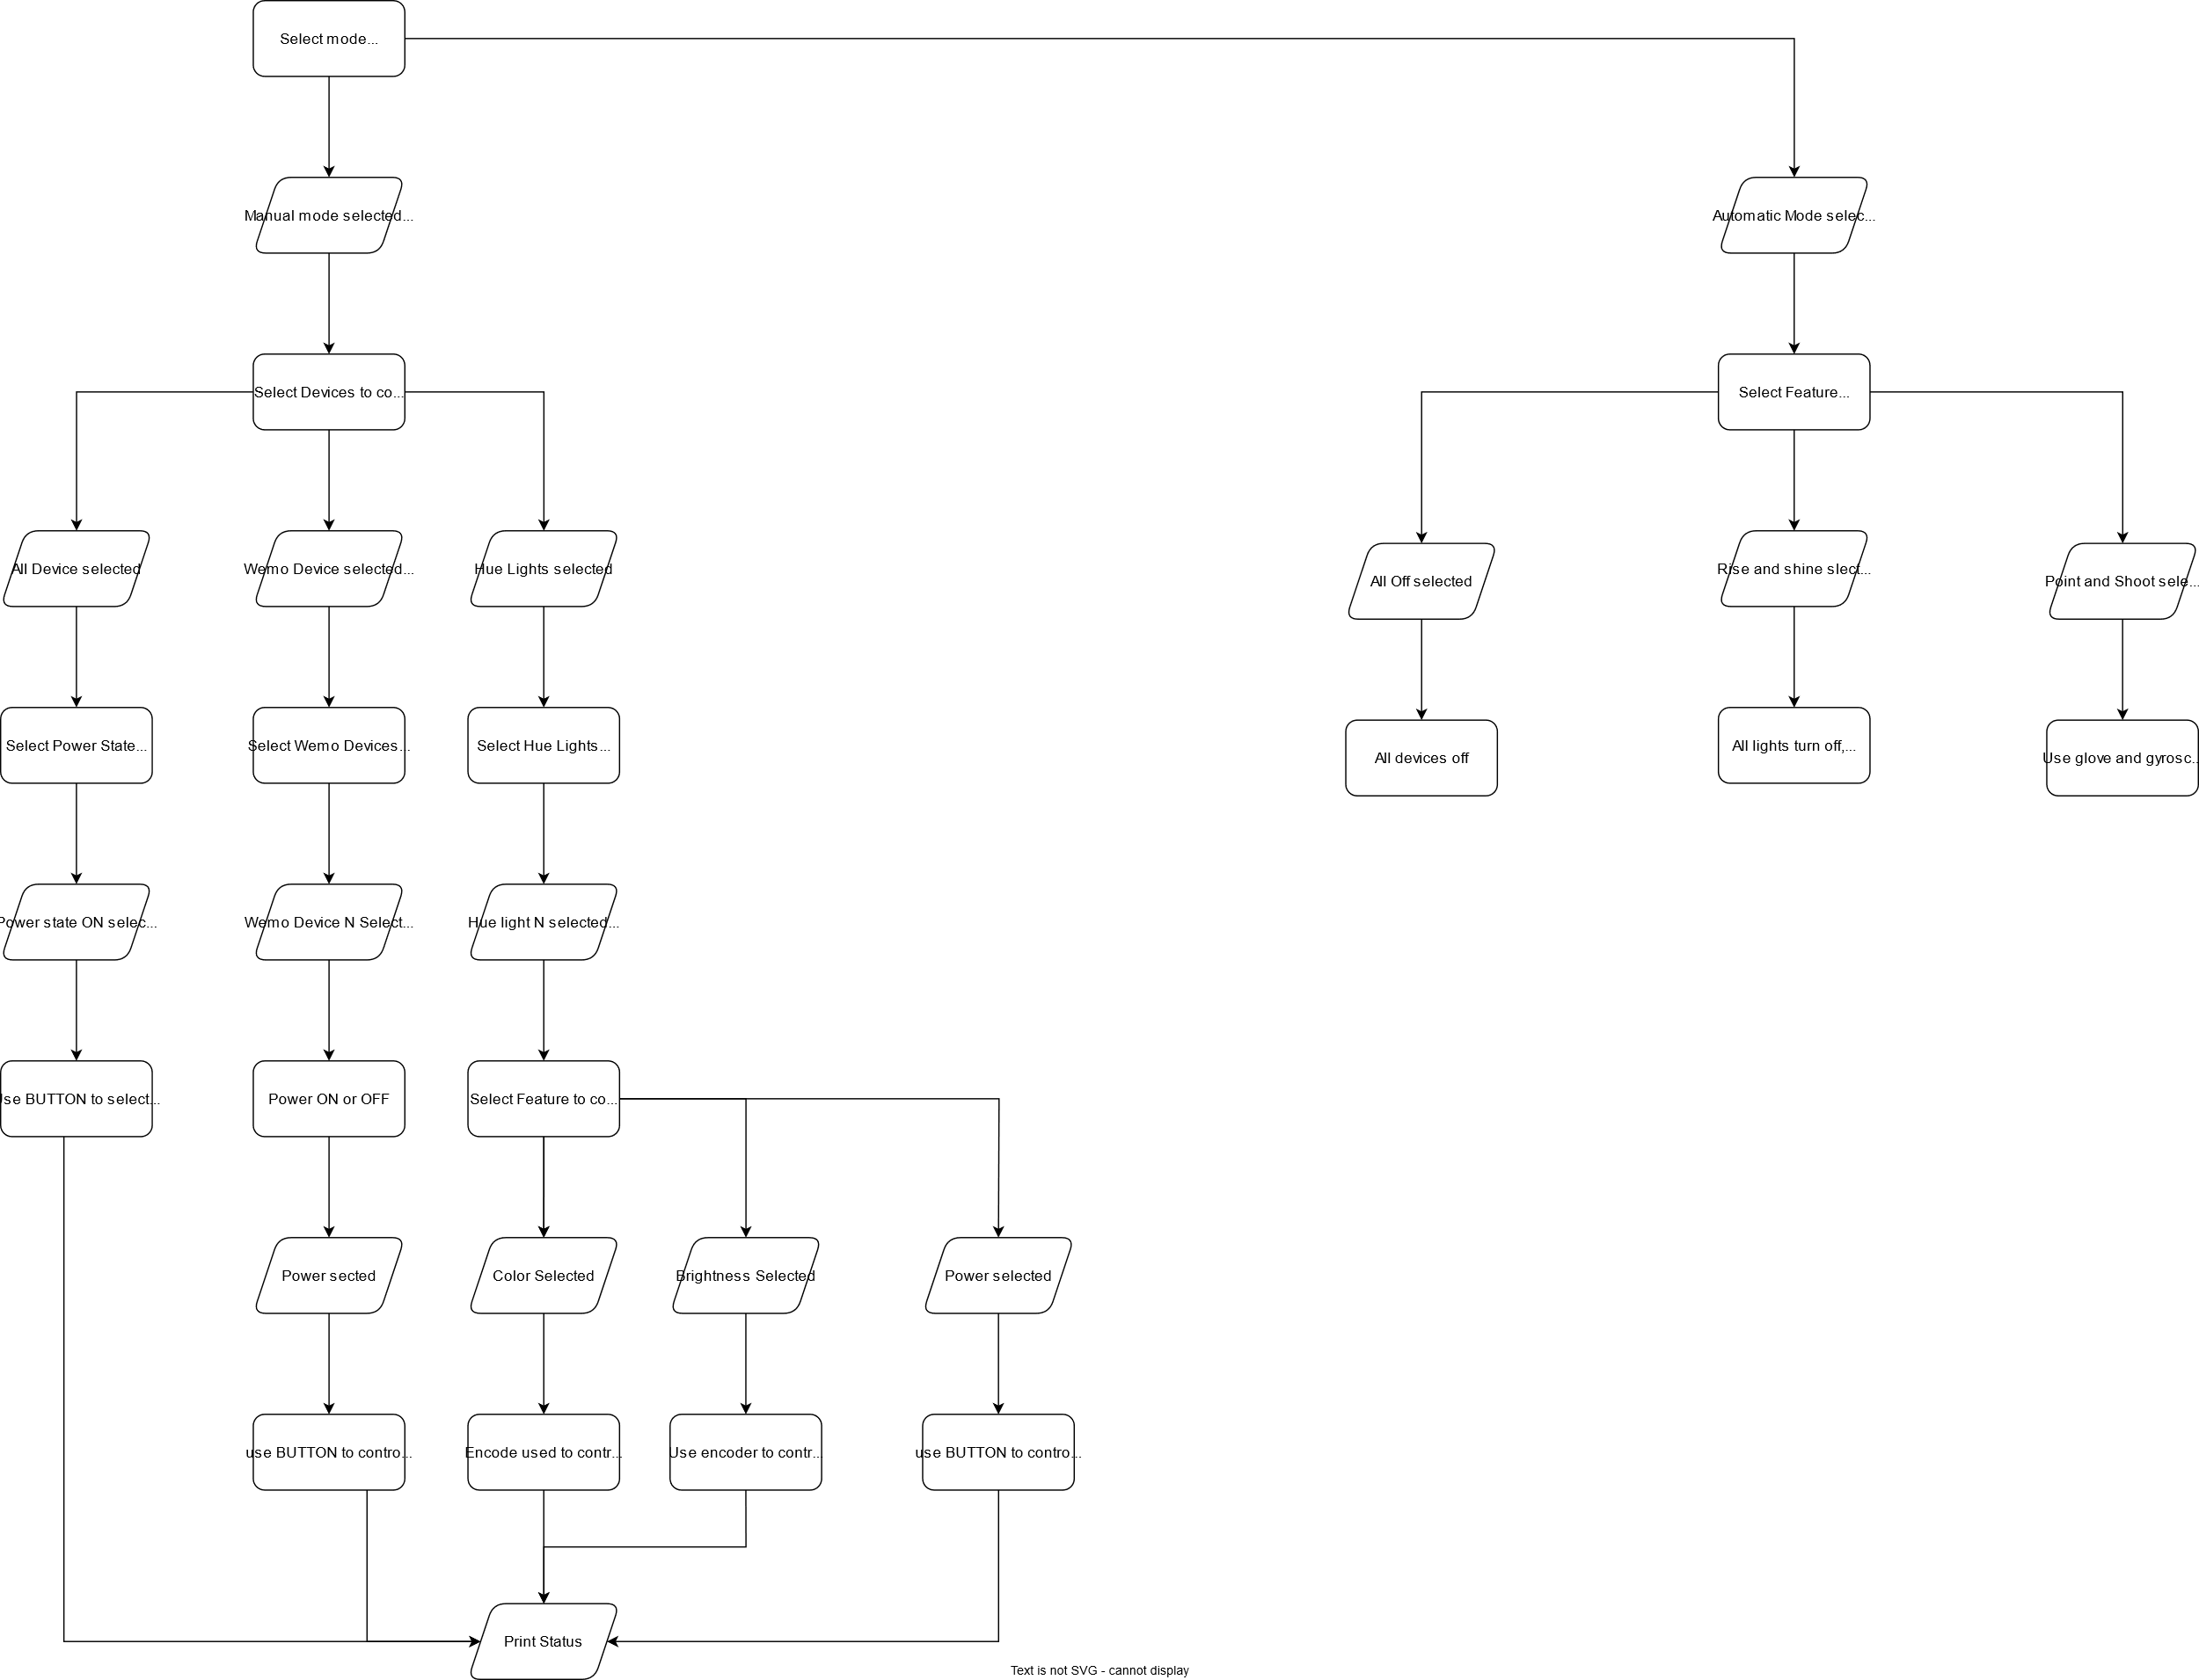
Menu Choice logic Basis for Menu screens

